Slide 1
GIS with Python！
PyConJP2021 2021/10/15
Chomoku LLC: Hideyuki Ogawa
Translate with DEEPL

Slide 2

自己紹介
Name: Hideyuki Ogawa (@ogawahideyuki)
Company: Chomoku LLC (@hijichomoku)
Founder & CEO
We are hiring!!! Sorry we have no english site. (japanese site)
where: Kyoto
hobby: Jogging / Learn Chinese / BTS / No drinking
Talk: PyConJP2019, PyCon China Beijing 2019, PyCon mini HIroshima, PyConJP 2020 Tutorial

Slide 3
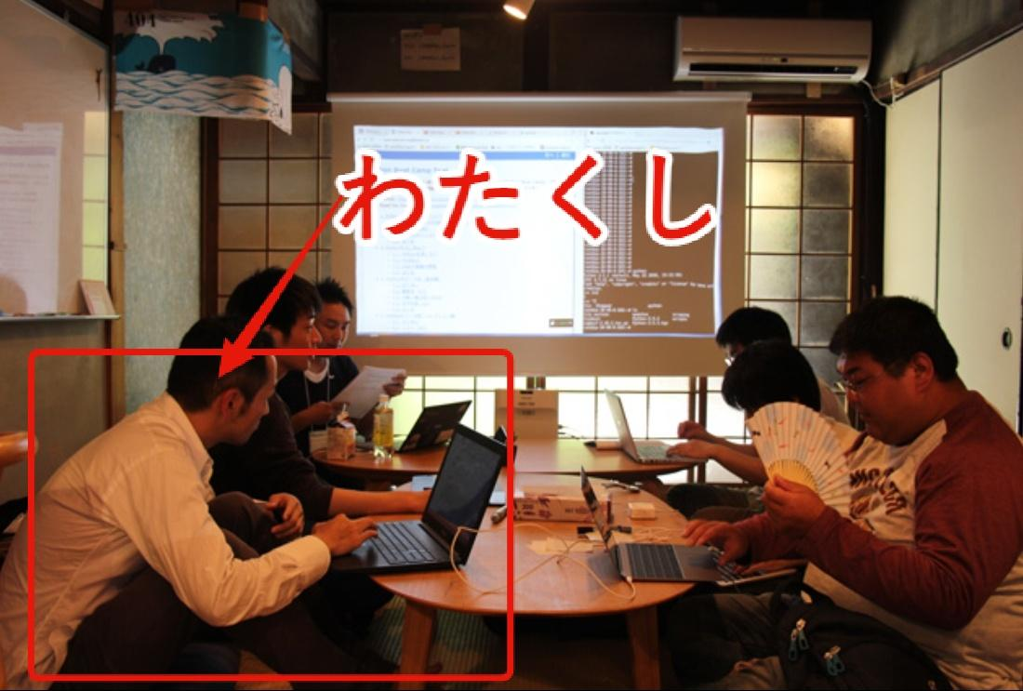
On PyConJP Blog
Python Boot Camp in 京都を開催しました
Notes:
ありがとう！PyConJP！ってドーンって文字が落ちてきてっていうアニメーションにしたい

Slide 4

Thank you! PyConJP!!!

Slide 5


Writing
I write about Dash. Dash is plotly’s Web Framework.

Slide 6

Hannari Python
Python community in Kyoto
Recently held Online!!!
Once a week
Social Tipping!!
Donate
PyCharity
Red Cross
Japanese Student Service Organization
https://hannari-python.connpass.com/

Slide 7
I appreciate before my talk.
To the medical community and all those who support society
Thank you!
Notes:
医療関係者、社会を支える全ての方たちありがとう！

Slide 8
Motivation for the talk.
I dealt with a lot of location data at work.
I realized the importance of location data in dealing with the real world we live in.
On the other hand, the usage is rarely talked about (me too. according to me).
Expectation that by talking, other people will start to talk about various things.
I'll talk about the basics and how to use them.
Also, there may be some mistakes, so if you notice any, please point them out to me!

Slide 9
Main Packages
shapely
Handling geospatial information
geopandas
Handling geospatial information as tabular data
xarray
Handling multidimensional data
folium / plotly / pydeck
Visualization of geospatial information

Slide 10
agenda
Location data / Geospatial information
File Formats
How to use
Personal behavior data
National census
Himawari
Satellite Images

Slide 11
agenda
Location data / Geospatial information
File Formats
How to use
Personal behavior data
National census
Himawari
Satellite Images

Slide 12
2020/2 ～ 2021/10
I can't go out.
In 2019, I'd be at PyConJP in Tokyo in September, and PyCon China Beijing in October.
But these days….
My area of activity（WFH : 2020/3 - 2021/10 99%）

Slide 13

North: MK BOWL KAMIGAMO

Slide 14

SOUTH: KYOTO STATION (KYOTO TOWER)

Slide 15
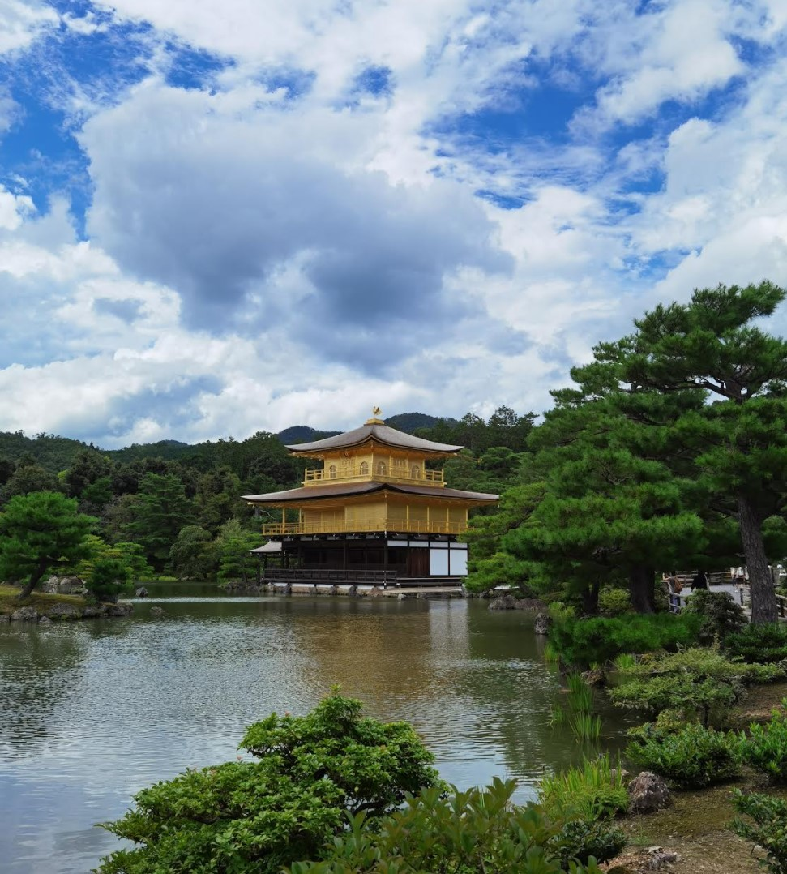
WEST: KINKAKUJI

Slide 16
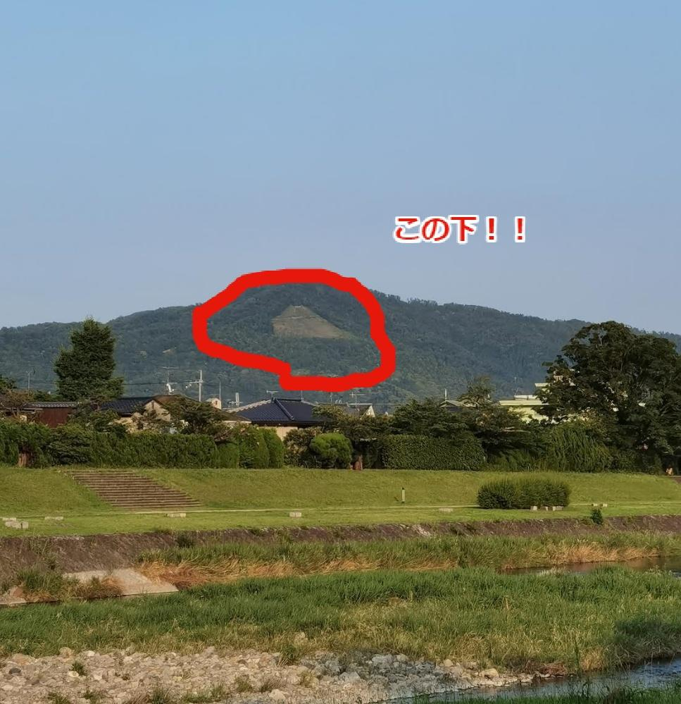
EAST: GINKAKUJI

Slide 17
Use Google Map
Only people in Kyoto would understand, so let's take a look on Google Maps!
Googlemap: My Place
https://goo.gl/maps/cFh66Zmg4j7cgfsG7
google is smart
Google Maps plots the location by name.
ex. Ginkakuji
Address: 〒606-8402 京都府京都市左京区銀閣寺町2
Maybe it's plotted as place name -> address -> coordinates.
Search by GinkakujiCoordinates -> Latitude and Longitude: 35.0270° N, 135.7983° E

Slide 18
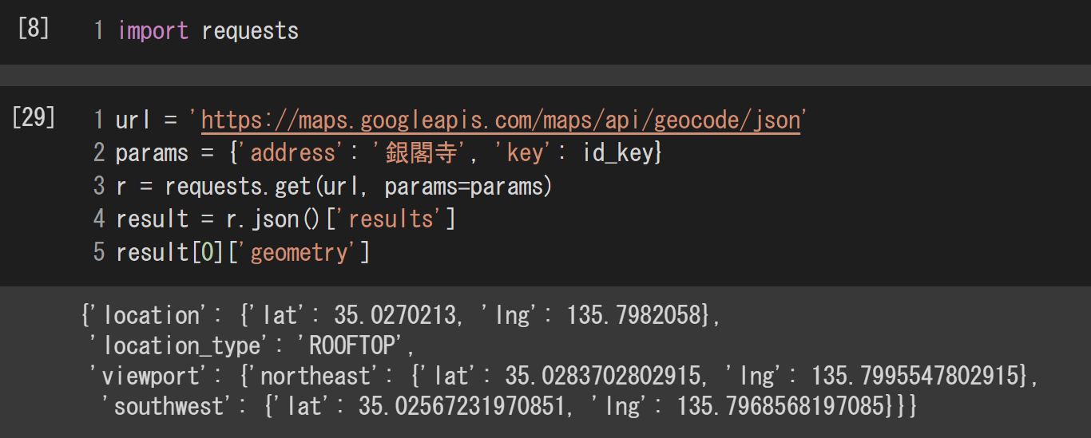
GeoCoding
Don't pass addresses when plotting location data.
Specify by coordinates such as latitude and longitude.
Conversion from place names and addresses to latitude and longitude is called geocoding.
Geocoding example (google's geocoding API: API_KEY required)

Slide 19
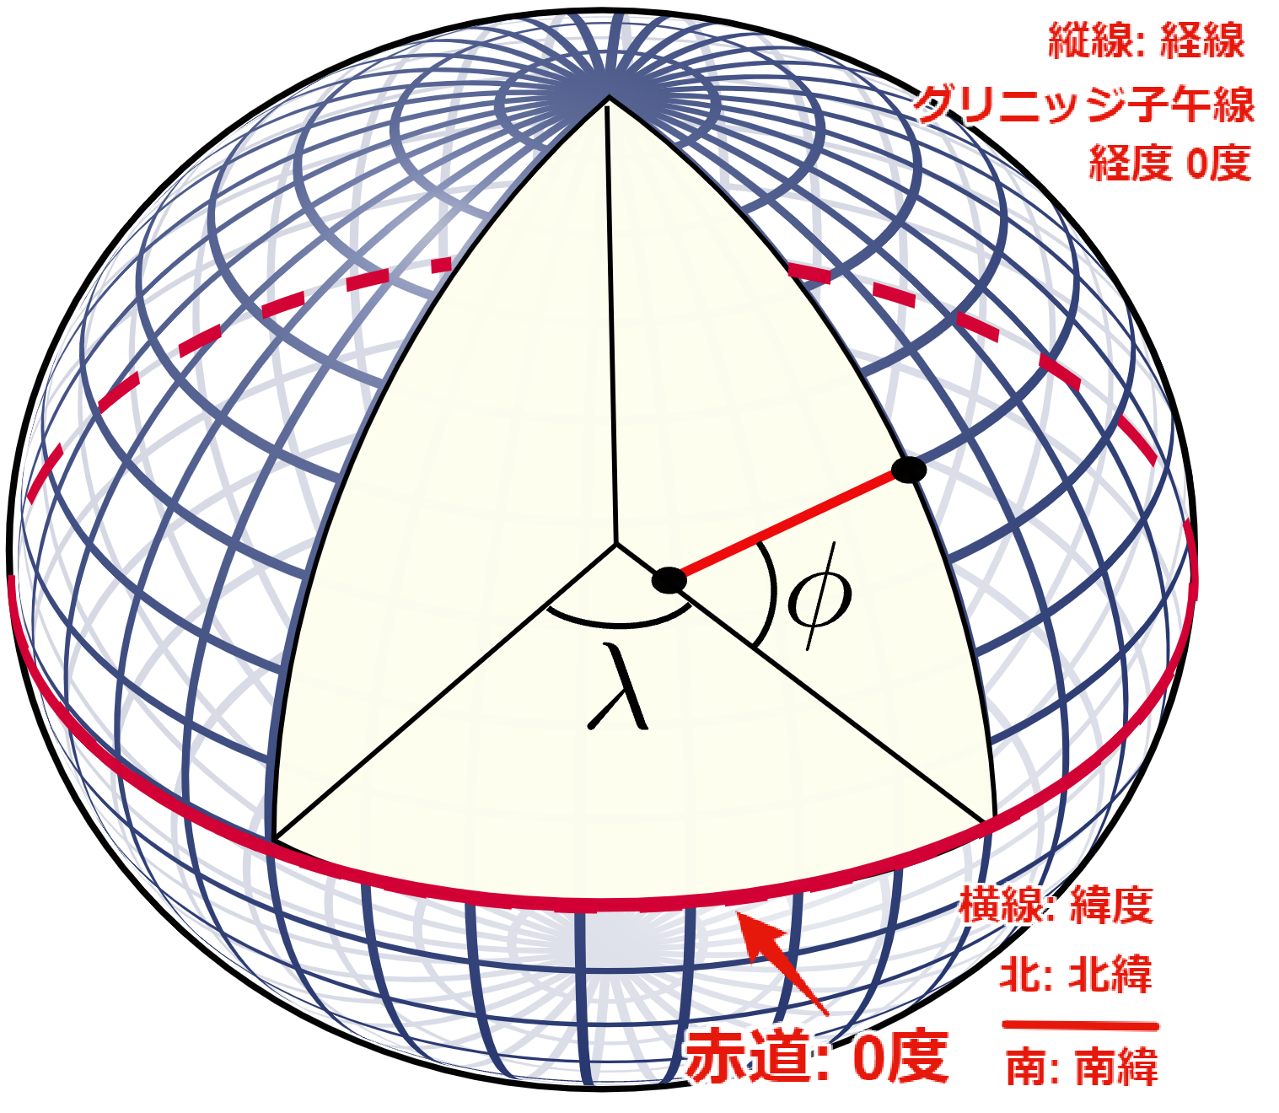
Coordinates
latitude and longitude
latitude
Represents north and south (up to 90 degrees)
0 degrees from the equator
longitude
Representation of east and west (up to 180 degrees)
0° prime meridian: 102.478m east of
Greenwich Observatory
Sometimes expressed as decimals, but often expressed in degrees, minutes, and seconds, and the minutes and seconds must be divided by 60.
Expressing latitude and longitude as numerical values can be used to identify locations.
On the other hand, there are multiple expressions, and it is very difficult to
image: Peter Mercator, Public domain, from wikimedia commons
Notes:
この辺りの解説を長くしても仕方がないので、ちょっと詳しめに作った感じを打ち消して、楕円を球面、平面に表すから色々あるんですよねぇ見たいな感じで短めに話す。

Slide 20
Coordinate Reference System（CRS）
There are multiple definitions for expressing position.
A geodesic system that defines what to do with a bumpy elliptical earth.
Representing the Earth as a Sphere? Coordinate system for planar representation.
A combination of many geodetic and coordinate systems => coordinate reference system
According to the GeoRepository site, there are 6547 CRSs.
It is run by The International Association of Oil & Gas Producers (IOGP).
If you don't pay attention to this, you won't be able to make use of the location data at all.
Please refer to books and other sources for accurate information.

Slide 21
Shapely
Use shapely to represent geospatial information
https://shapely.readthedocs.io/en/stable/
Express space using Point, LineString, and Polygon
Pass numerical values in the order of x, y (longitude / latitude)
There is also Multi * that puts each together.
Point : MultiPoint
LineString : MultiString
Polygon : MultiPolygon
Notebook Link
Colab: https://colab.research.google.com/drive/1CU8jzoLs8Hv0NNmHqES3gtYqneX_PvNJ?usp=sharing

Slide 22
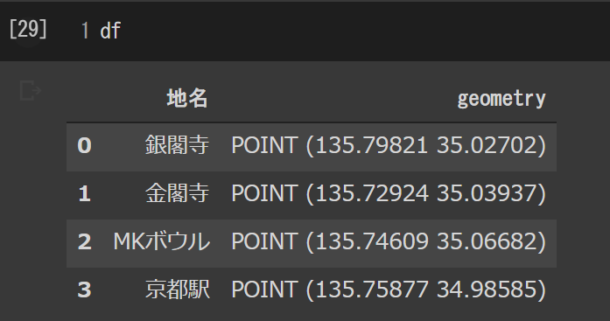
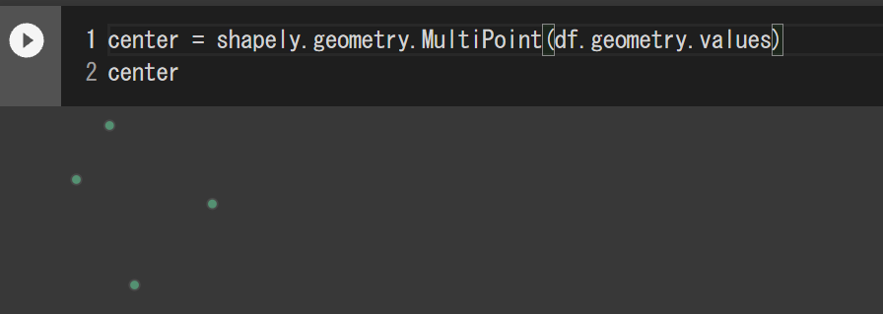
Express the area of my activity with Point
Expressed in latitude and longitude
When set to MultiPoint, it is displayed with 4 points

Slide 23
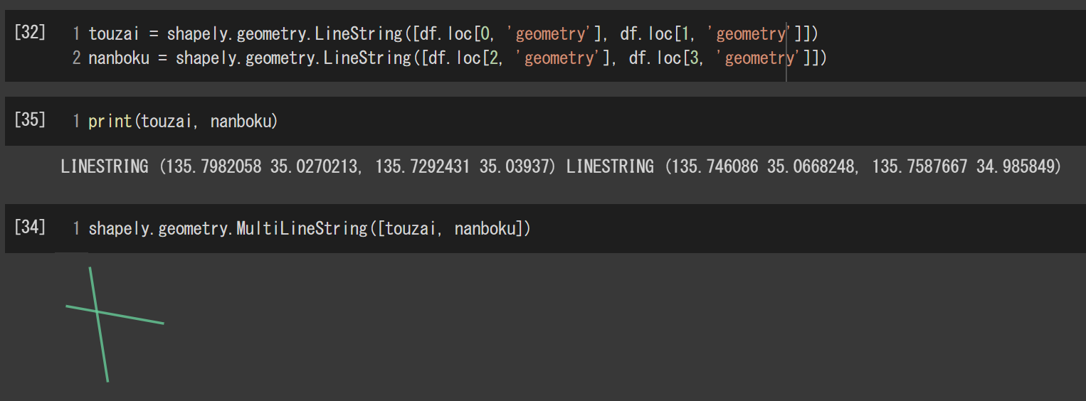
Express the area of my activity with LineString
If you pass a Point to multiple LineStrings, it will be represented by a line.
Let's make a line between east and west, north and south.

Slide 24
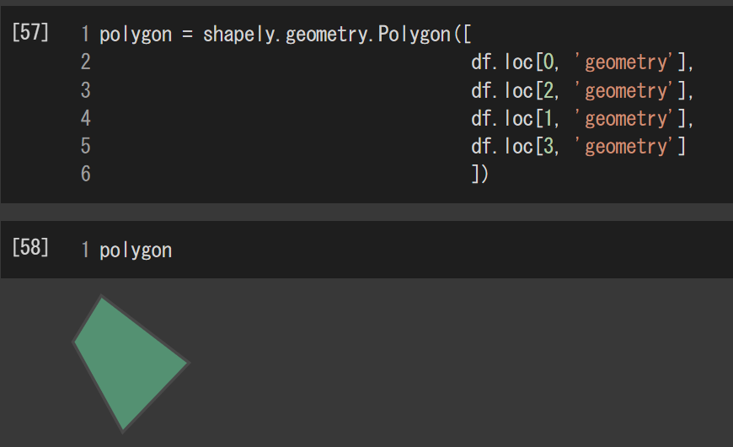
Express the area of my activity with Polygon
When multiple Points are passed, they are represented as Polygon.
Convert four points to a Polygon.

Slide 25
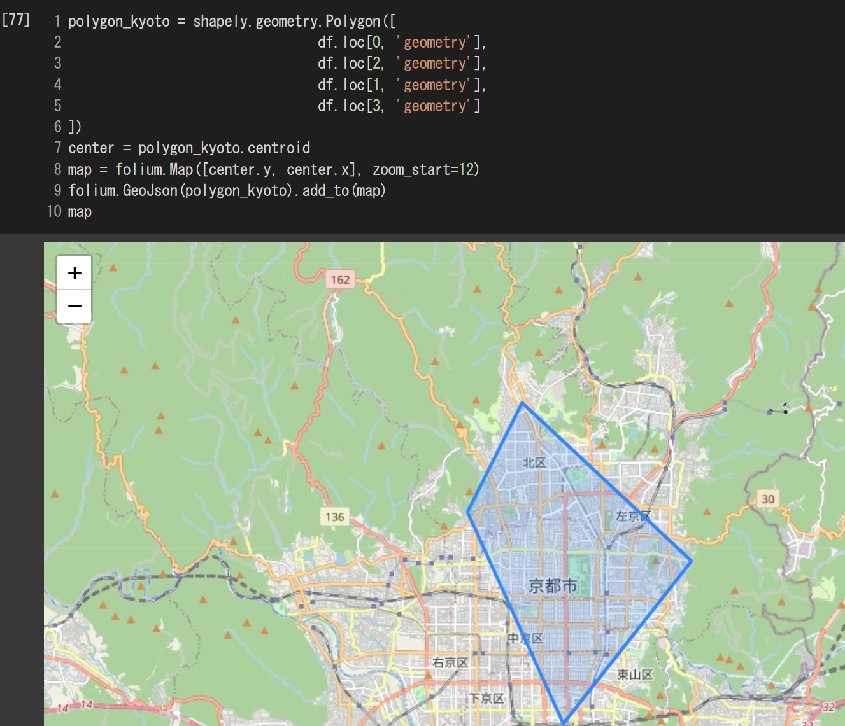
Plotting
Plotting with folium.

Slide 26
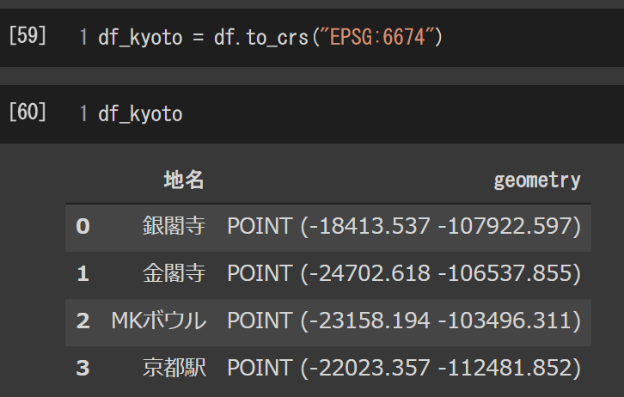
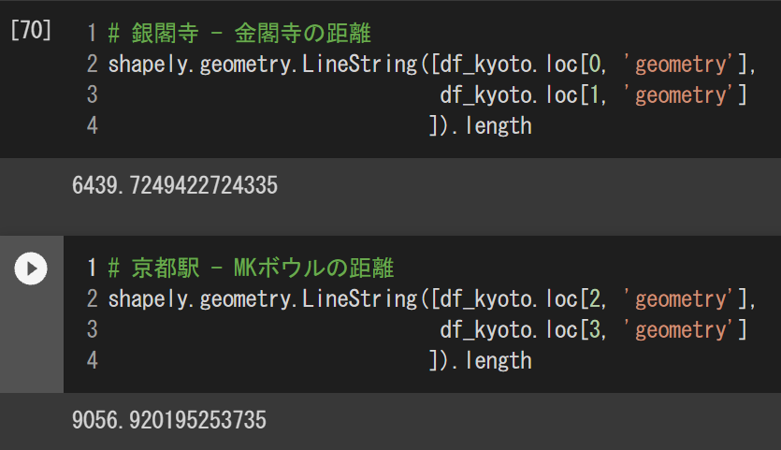
Measure distances by transforming the coordinate reference system.
In this case, EPSG4326 => EPSG6674
By doing so, we can measure the distance between line segments.
There are various attributes.

Slide 27
agenda
Location data / Geospatial information
File Formats
How to use
Personal behavior data
National census
Himawari
Satellite Images

Slide 28
agenda
Location data / Geospatial information
File Formats
How to use
Personal behavior data
National census
Himawari
Satellite Images

Slide 29
File Formats
Raster Data
Data is stored in a grid.
File format: GeoTIFF, etc.
Packages: rasterio, xarray
Vector Data
Data created from points, line strings, and polygons
File formats: Shape, GeoJSON, KML, etc.
Shapefile consists of about 3-5 files.
Packages: geopandas

Slide 30
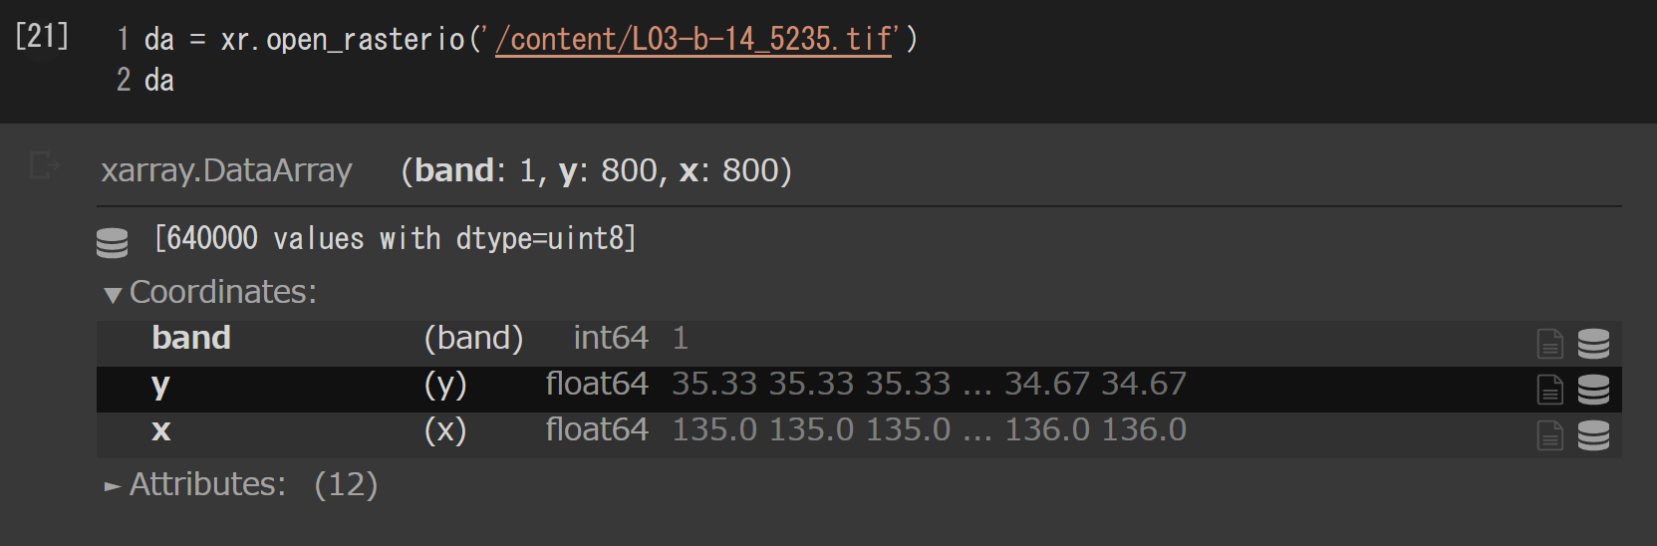
Raster Data
Data: National Land Information: Land use fine mesh (raster version)
https://nlftp.mlit.go.jp/ksj/gml/datalist/KsjTmplt-L03-b_r.html
Handling the Kyoto area: 5235
Unzip the zip and load the tif file with xarray's open_rasterio function.
The data are stored in 100m mesh at each location with the values of land cover classification.
Actual reading and objects.

Slide 31
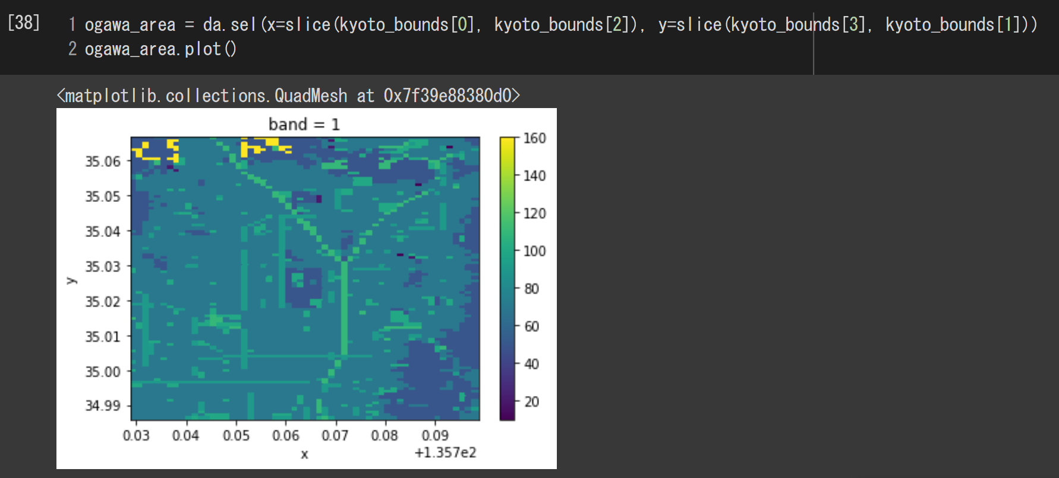
Raster Data 2
Cut out area of my activity.
Can be visualized with the plot method.
Using xarray makes it easy to cut out data.

Slide 32
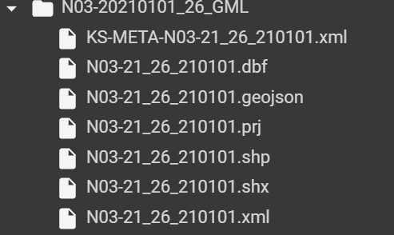
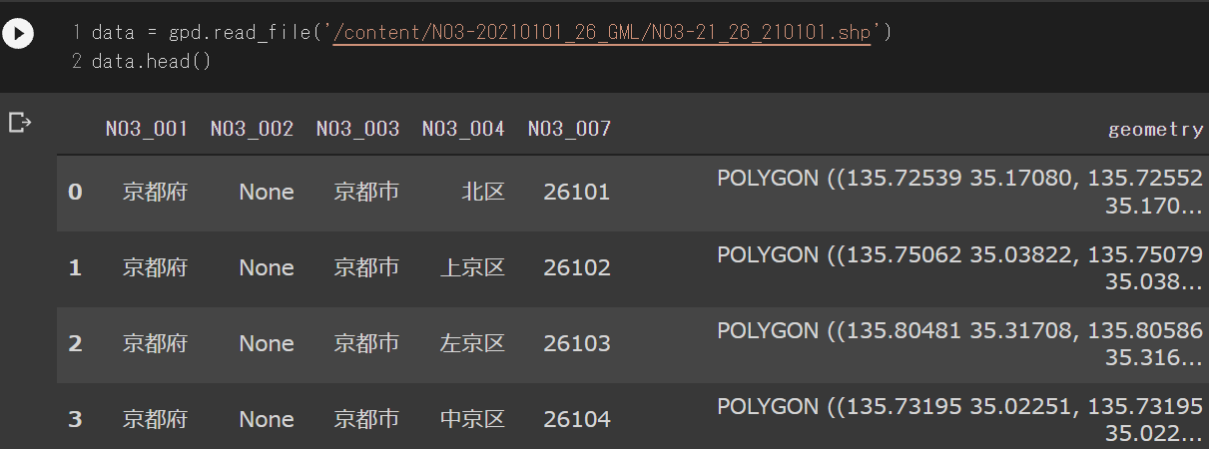
Vector Data
Data used: National Land Data: Administrative Area Data
https://nlftp.mlit.go.jp/ksj/gml/datalist/KsjTmplt-N03-v3_0.html#!
As usual, kyoto data.
The ZIP contains both shape and geojson.

Slide 33
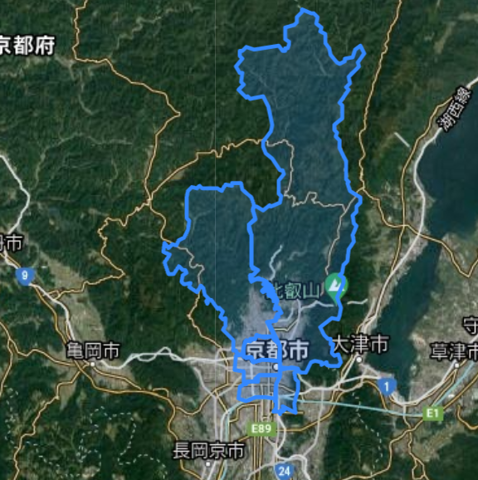
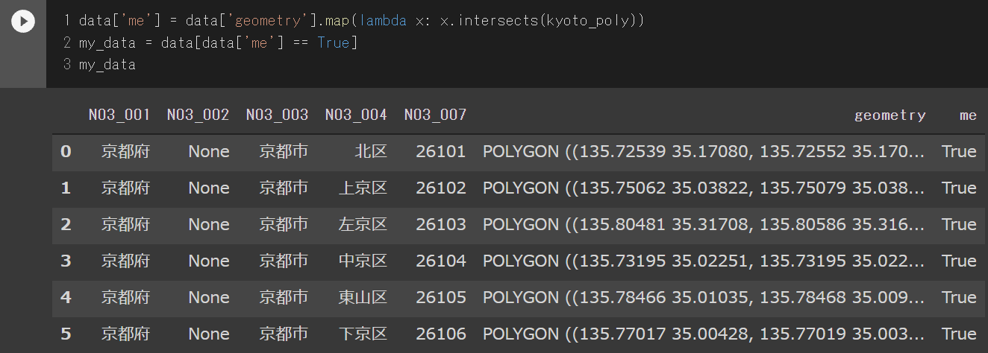
Vector Data 2
Find out which wards are in my activity.
Use intersects method.
visualize with folium
The light blue area is vector data.
With google satellite data.
I was surprised by the length of Sakyo Ward.

Slide 34
agenda
Location data / Geospatial information
File Formats
How to use
Personal behavior data
National census
Himawari
Satellite Images

Slide 35
agenda
Location data / Geospatial information
File Formats
How to use
Personal behavior data
National census
Himawari
Satellite Images

Slide 36
Personal behavior data
Data: GPS trajectory linked data project
https://github.com/koujikozaki/GPS2LOD (CC4.0)
CSV file
Description: Behavior during a conference
We have time and location data, altitude, speed, etc.
I'll observe the data to see if everyone was acting seriously.
colab: https://colab.research.google.com/drive/1_LNM-AKdpcuJb-vOzPKJt3O81o1jOGia?usp=sharing
data processing
We will use speed, location, and personal information.
Converted the data to every 30 minutes.
Point type for position information that exists as a float.
DataFrame => GeoDataFrame
CSV => GeoJson

Slide 37
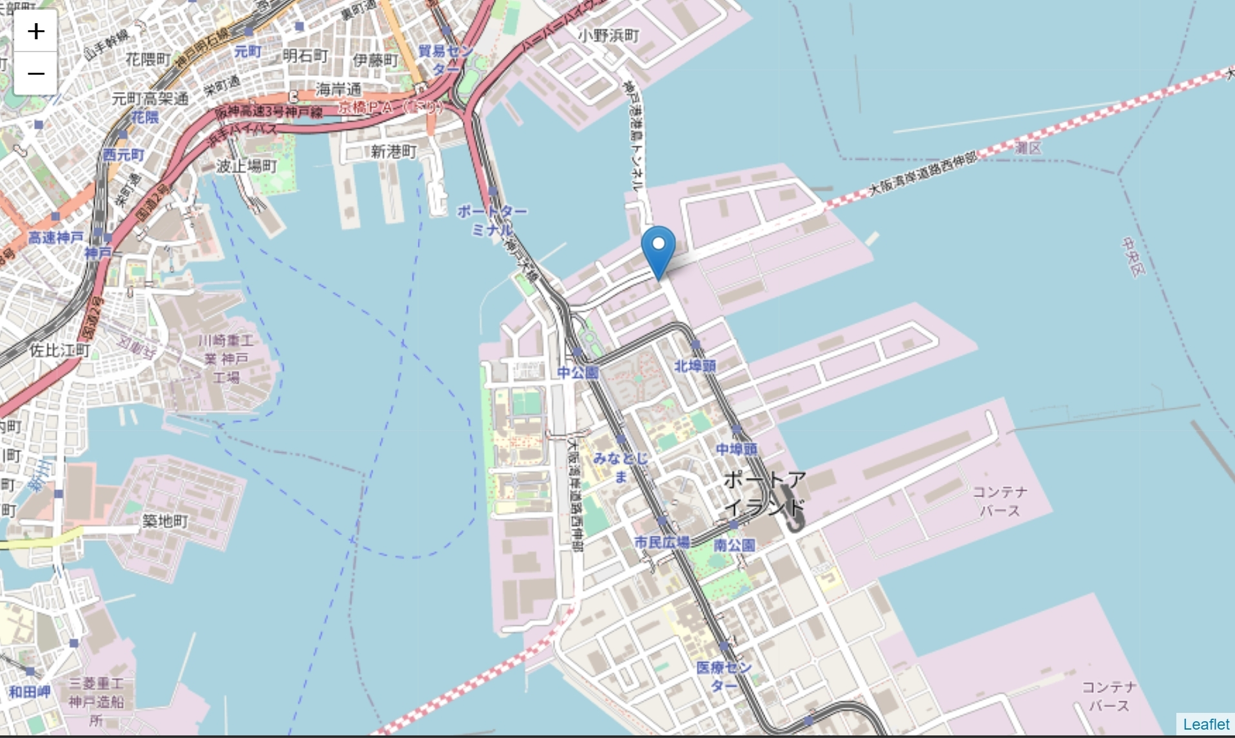
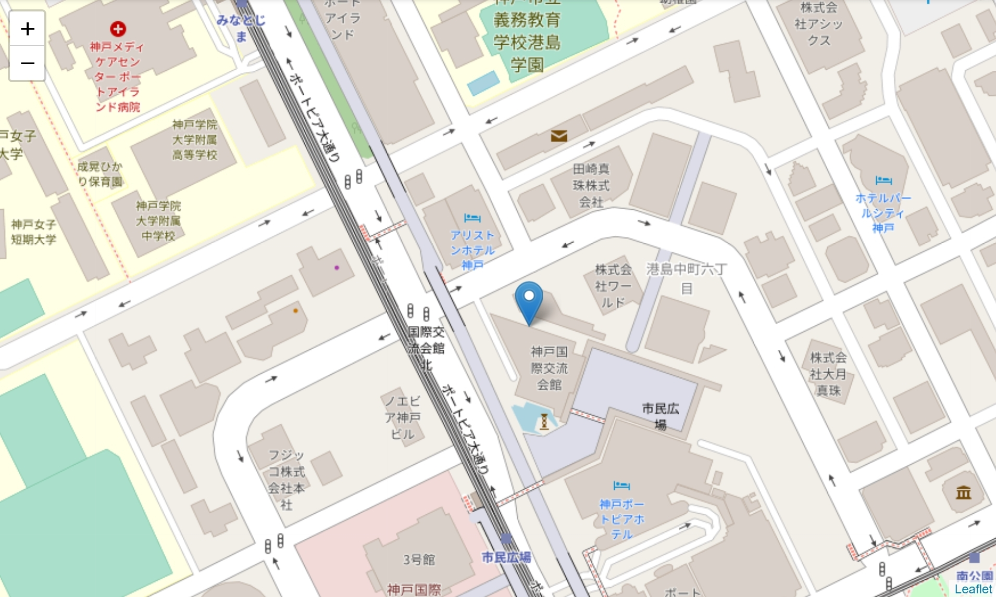
Personal behavior data 2
What is the central point of everyone's actions?
It can be obtained with the centroid attribute of MultiPoint, but it is the center of movement... (left)
I created a median from position data that is a float (right): Bingo!

Slide 38
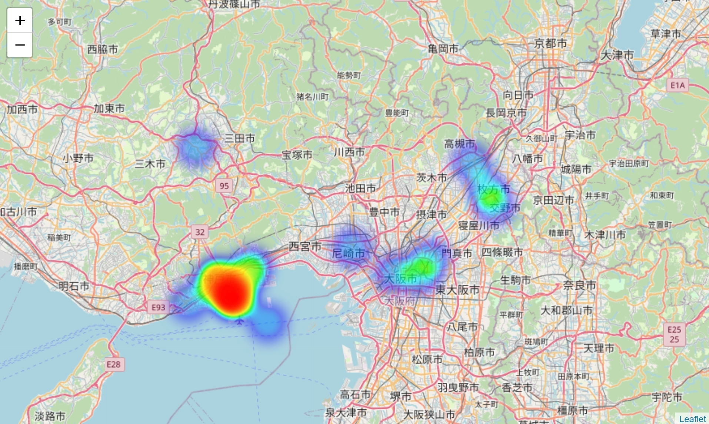
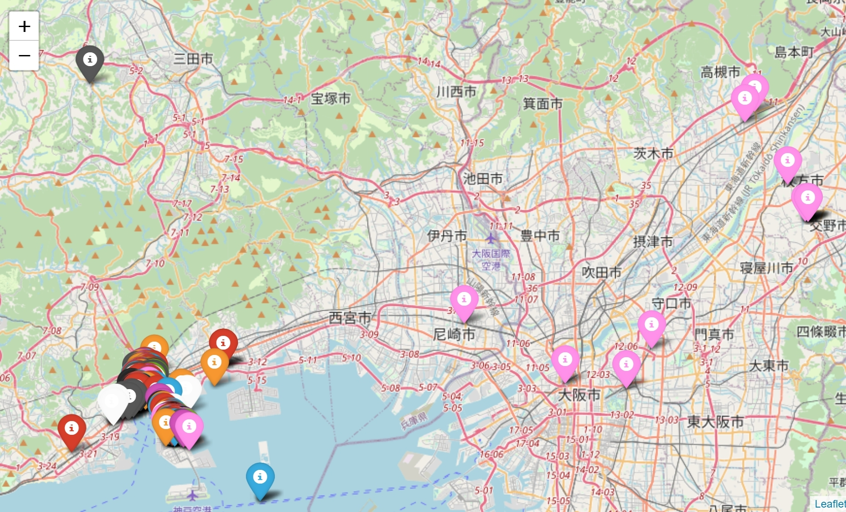
Personal behavior data 3
Observe the behavior of all people.
Use heat maps to observe where the frequency was highest.
Observe each individual by separating them by color.

Slide 39
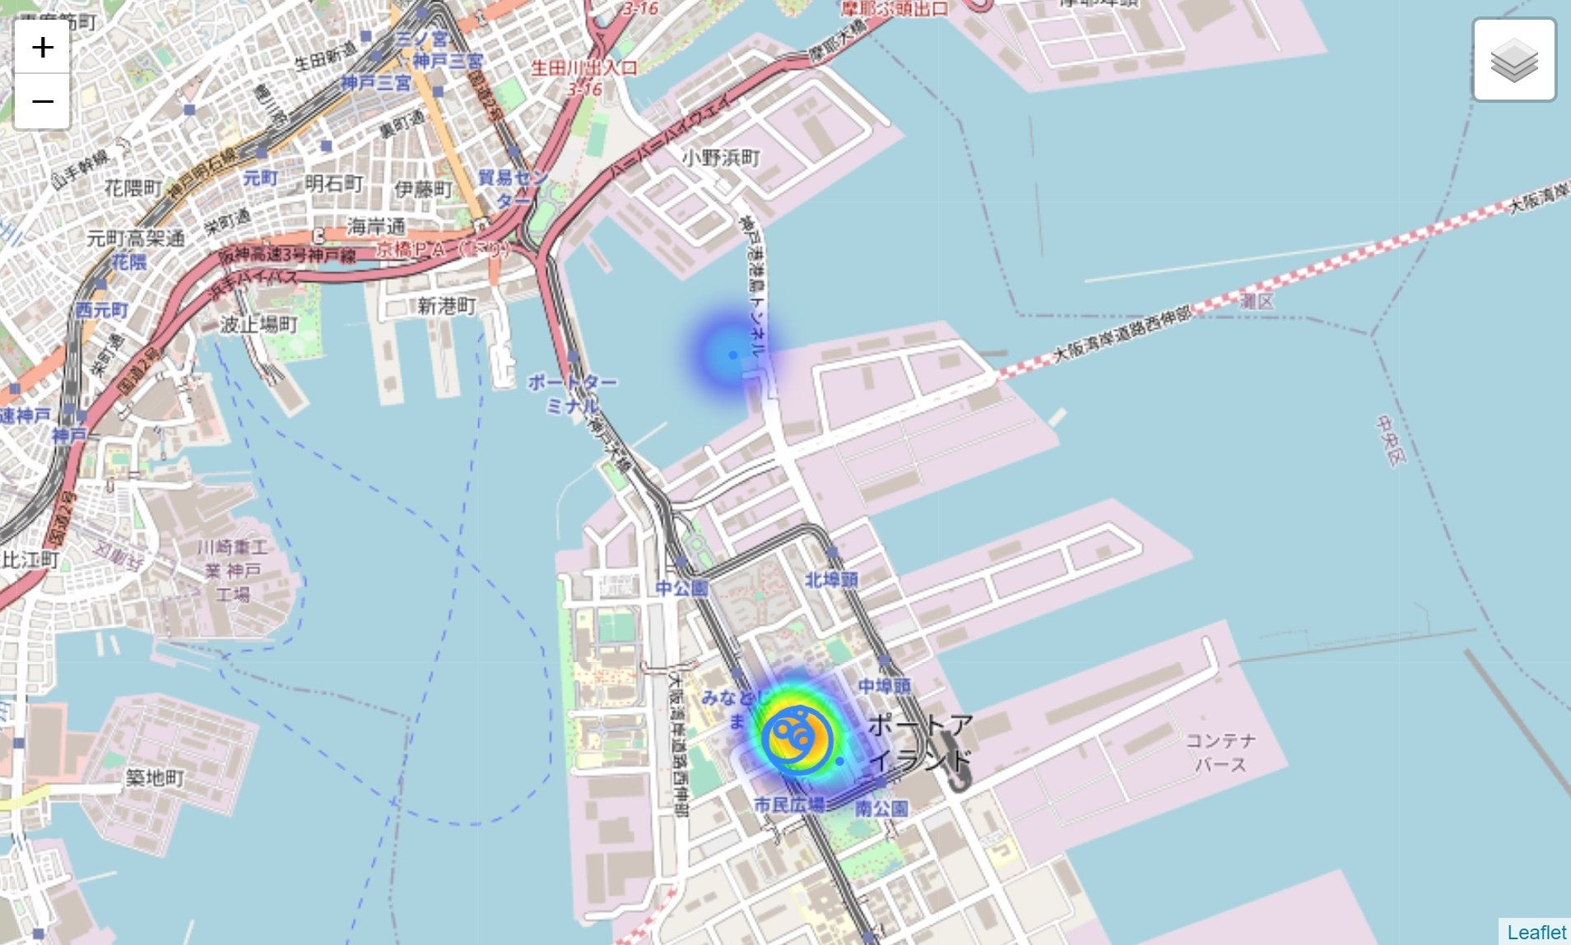
Personal behavior data 4
The speed of each individual at a given point in time is represented by the size of the circle.
Heat map representation of how many people are gathering.

Slide 40
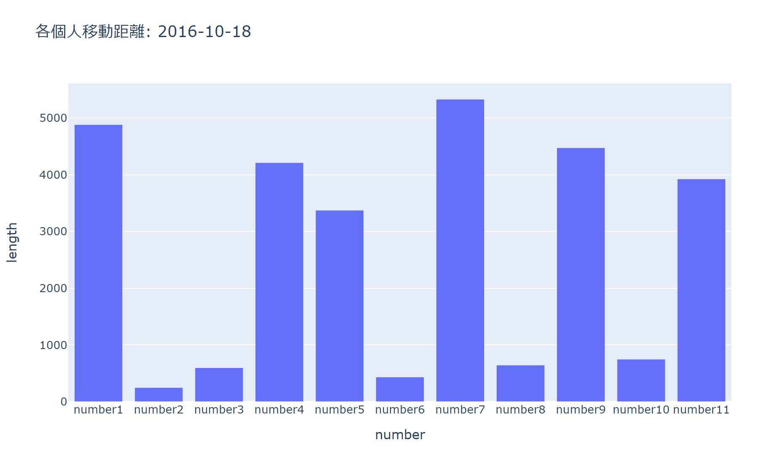
Personal behavior data 4
Compare the daily latitude distance for each individual
Change the coordinate reference system to express in meters.（EPSG4326 => EPSG6673）

Slide 41
agenda
Location data / Geospatial information
File Formats
How to use
Personal behavior data
National census
Himawari
Satellite Images

Slide 42
agenda
Location data / Geospatial information
File Formats
How to use
Personal behavior data
National census
Himawari
Satellite Images

Slide 43
National census
Census is the most important statistical survey of the country.
We can also get data on the number of people in each household, their ages, etc.
Nationwide, divided by town/character, data created by 1km, 500m, 250m mesh.
Statistical data and boundary data are kept separately, and regional data is created by merging the two.
Can be obtained in csv and shape file(zipped up).
https://www.e-stat.go.jp/gis
In this article, we will show examples of marketing using basic statistics such as population.
Marketing to ages 0-14
Marketing to foreign residents
Colab: https://colab.research.google.com/drive/1QspBpoW9BO_ofXmrLOX3a04YD5SE_3eH?usp=sharing

Slide 44
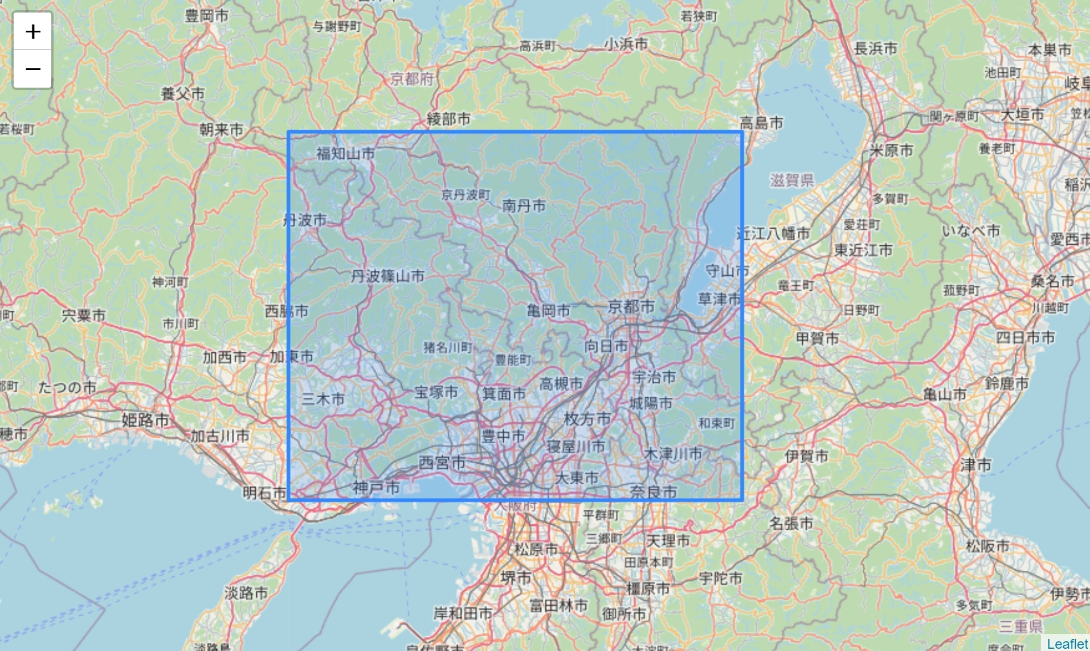
National census 2
We have created a data set that includes the central part of Kyoto.
Data on total population, sex ratio, age structure, number of households, etc. on a 250-meter mesh
Merged with KEY_CODE.

Slide 45
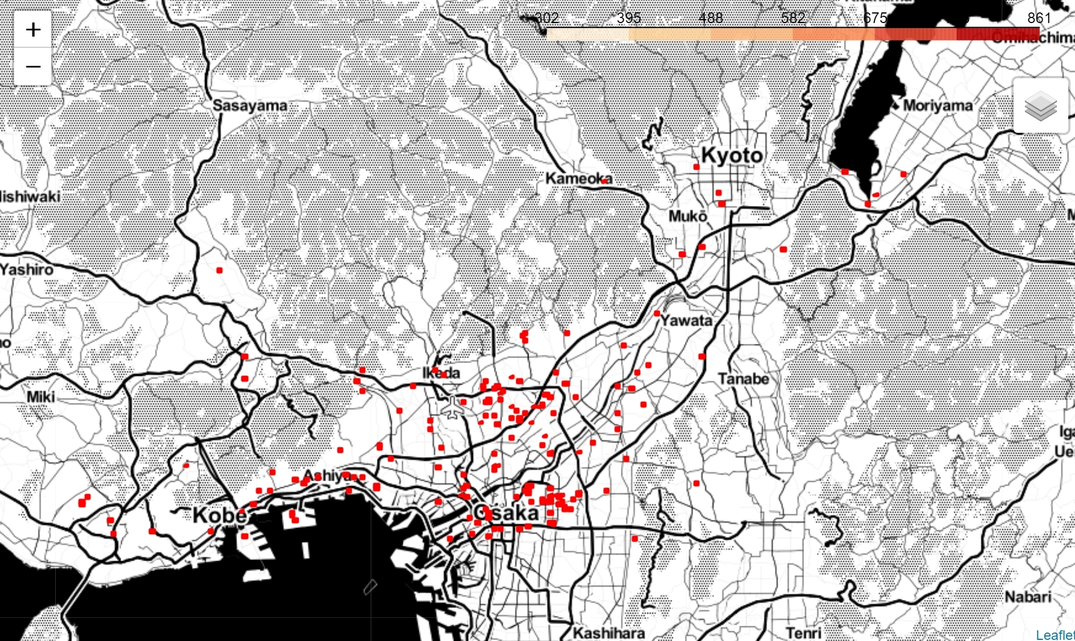
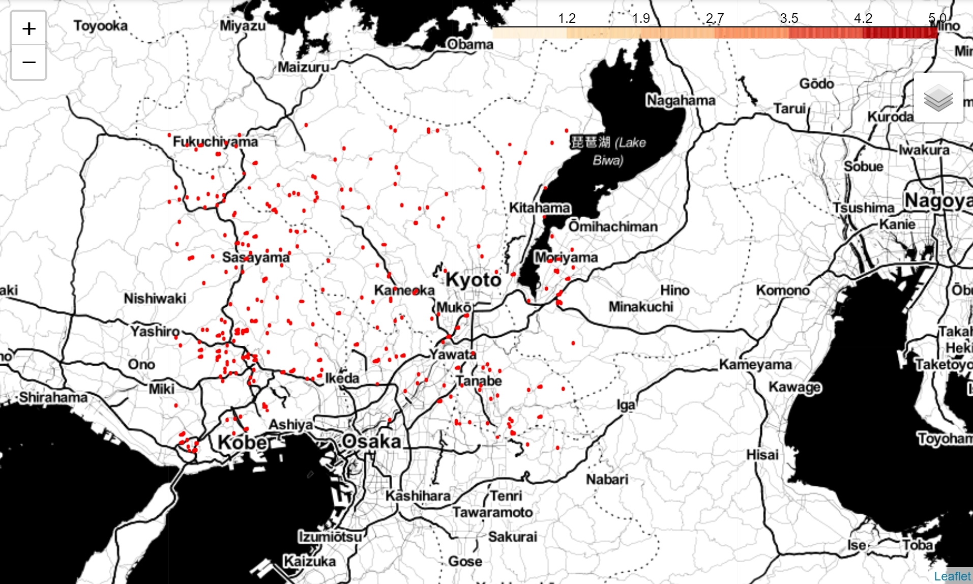
National census 3
Use the 0-14 year old population to find areas that are likely to have a younger population.
Separate by total number and ratio (300+, 40%)
This area can be created with Pandas-like processing.

Slide 46
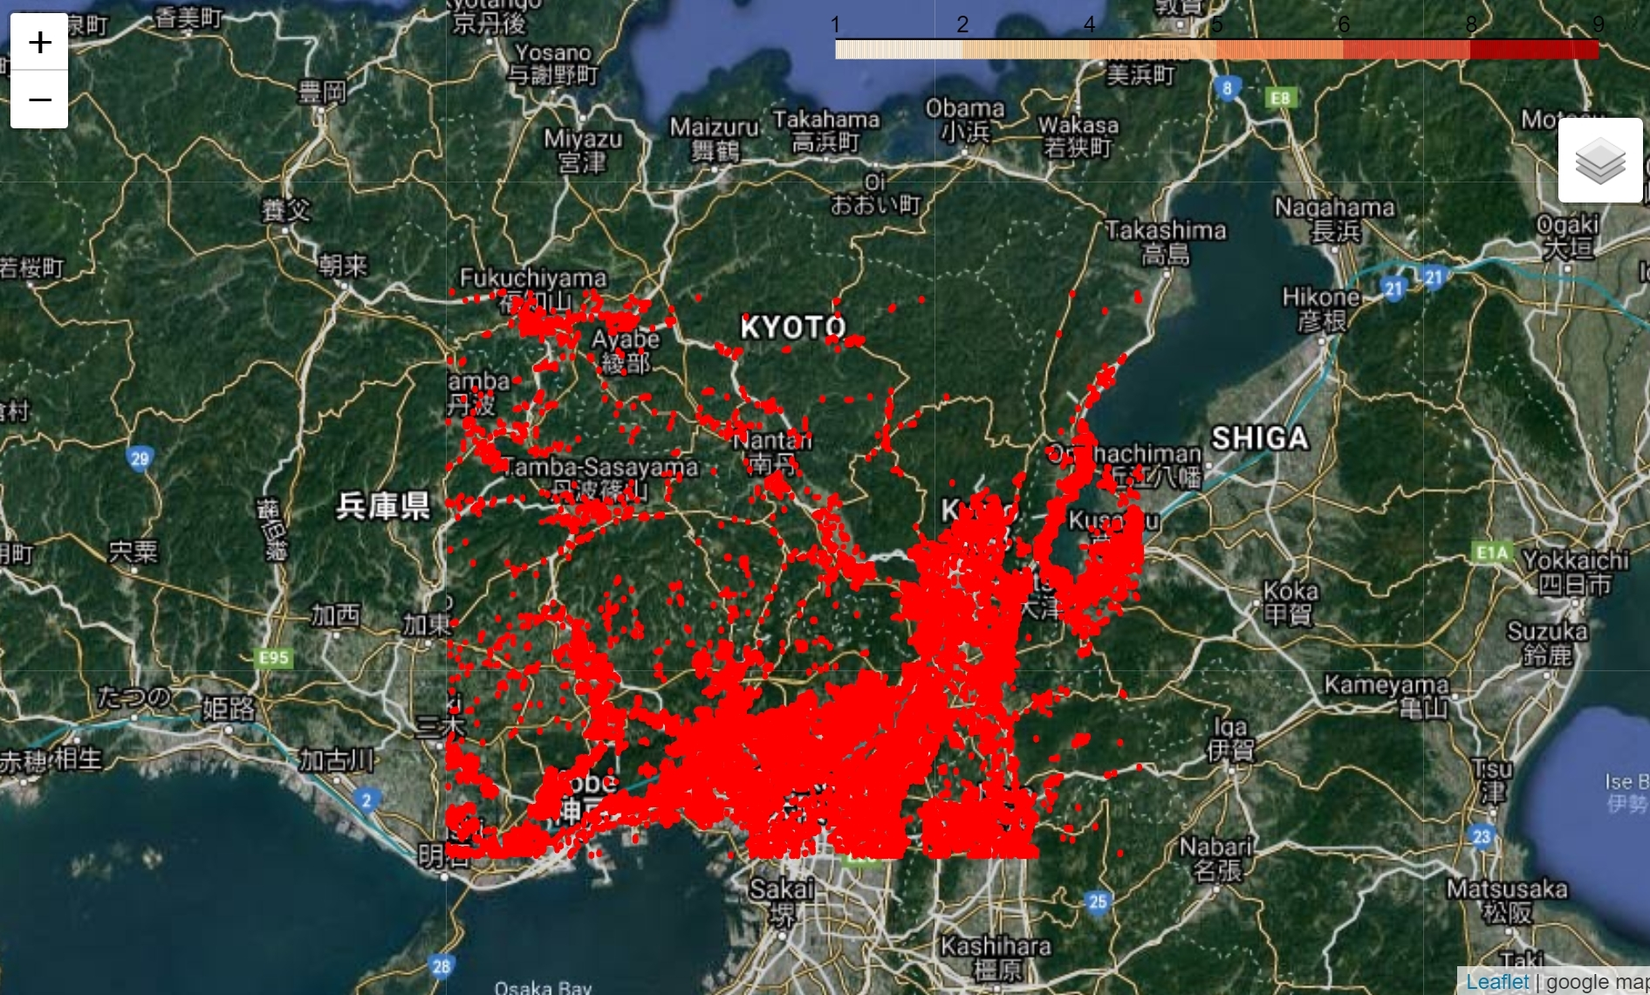
National census 4
Delivering information to foreign residents.
The less foreigners they have nearby, the more difficult it will be to get information.
Find areas with less than 10 people on a 250 meter mesh.

Slide 47
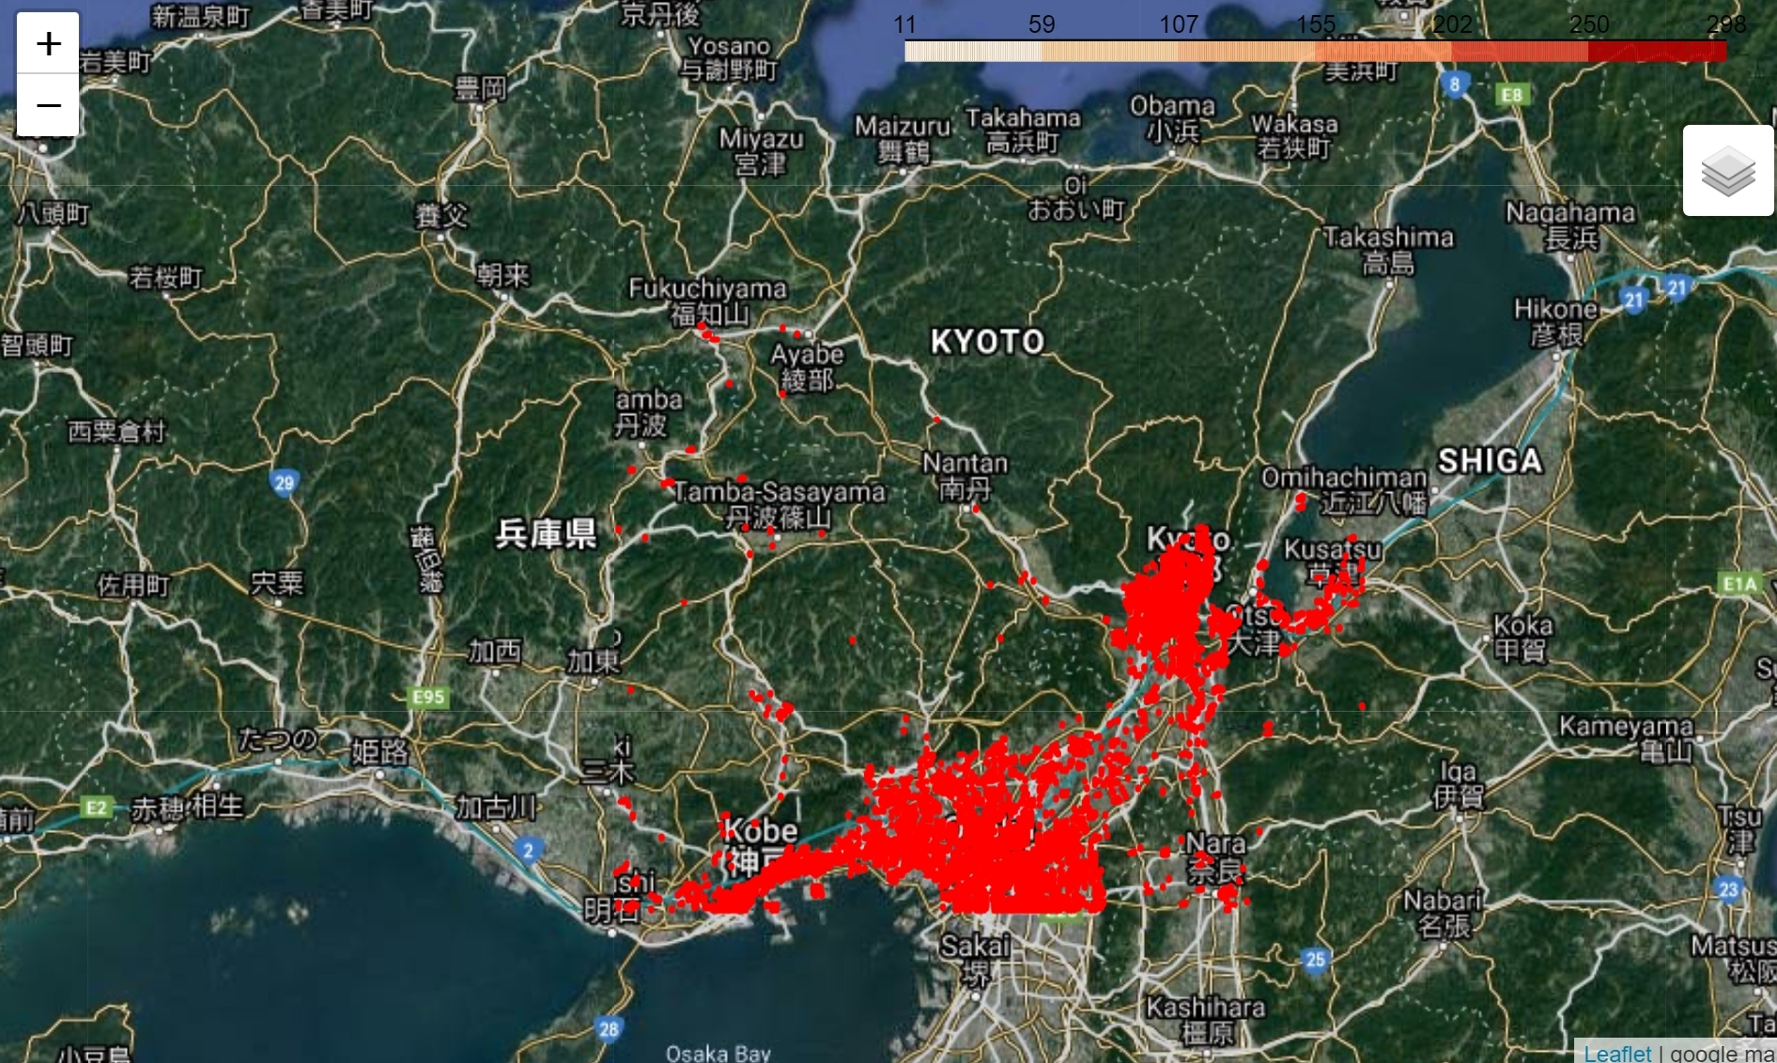
National census 5
There were more people under 10 than I expected, so I checked for people over 10.

Slide 48
agenda
Location data / Geospatial information
File Formats
How to use
Personal behavior data
National census
Himawari
Satellite Images

Slide 49
agenda
Location data / Geospatial information
File Formats
How to use
Personal behavior data
National census
Himawari
Satellite Images

Slide 50
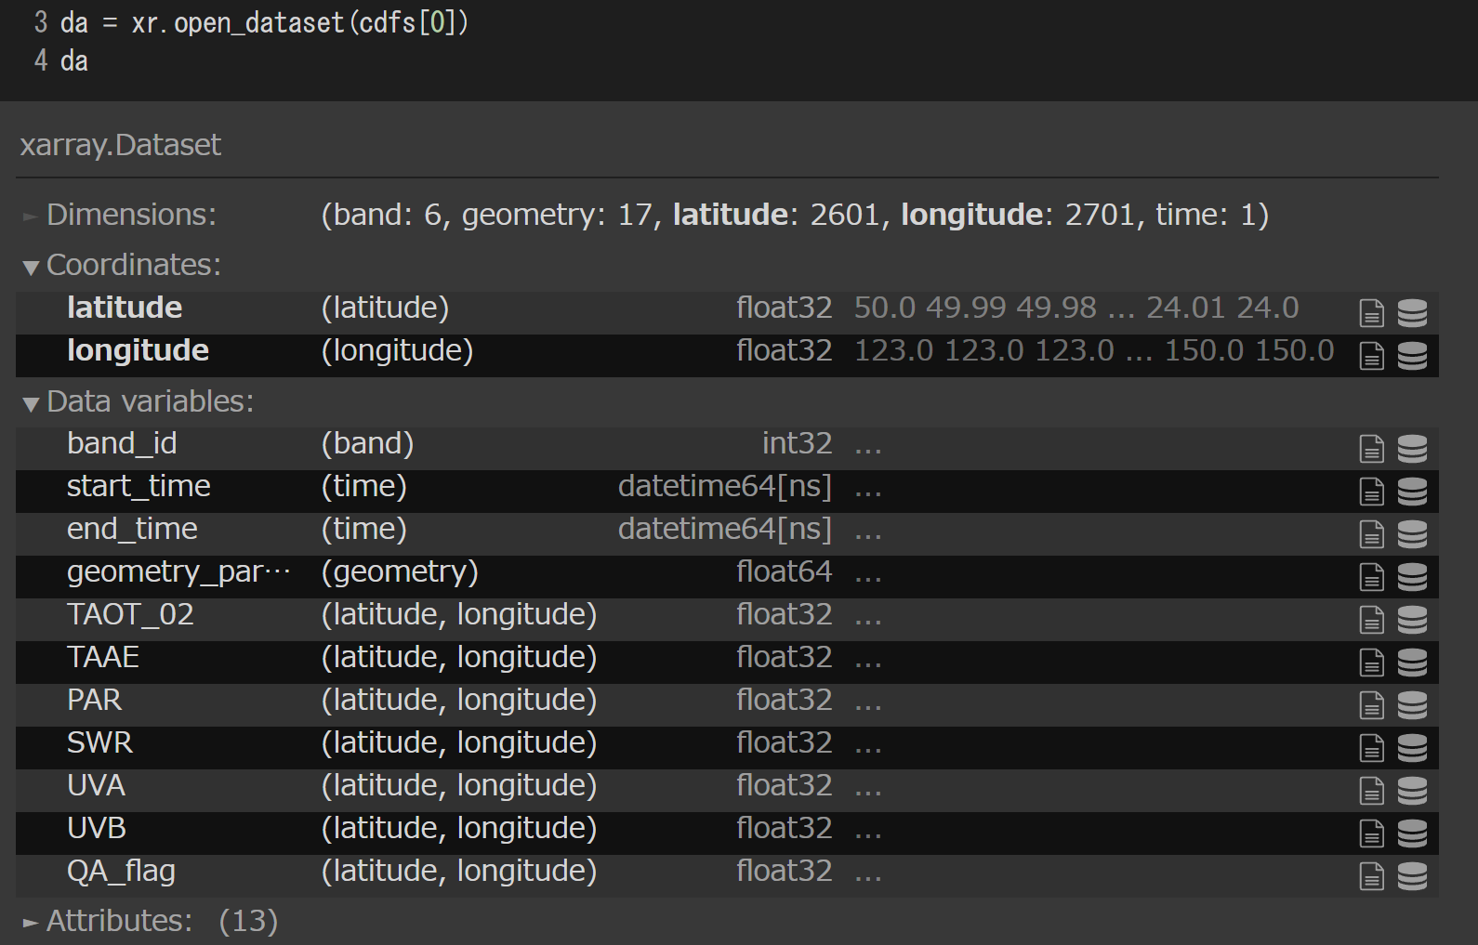
Meteorological data with xarray
Data: PTree 「(c) JAXA・気象庁」
Colab: https://colab.research.google.com/drive/1J3QU3Hv2iO1EKYGKma96CkkFeVqqzzrD?usp=sharing
Description https://www.eorc.jaxa.jp/ptree/userguide_j.html
Non-commercial use only.
Buy it if it's commercial use!
Data is in NetCDF format
Multidimensional Array
Use xarray
What to do
See how the amount of sunlight
changes over the of a day.

Slide 51
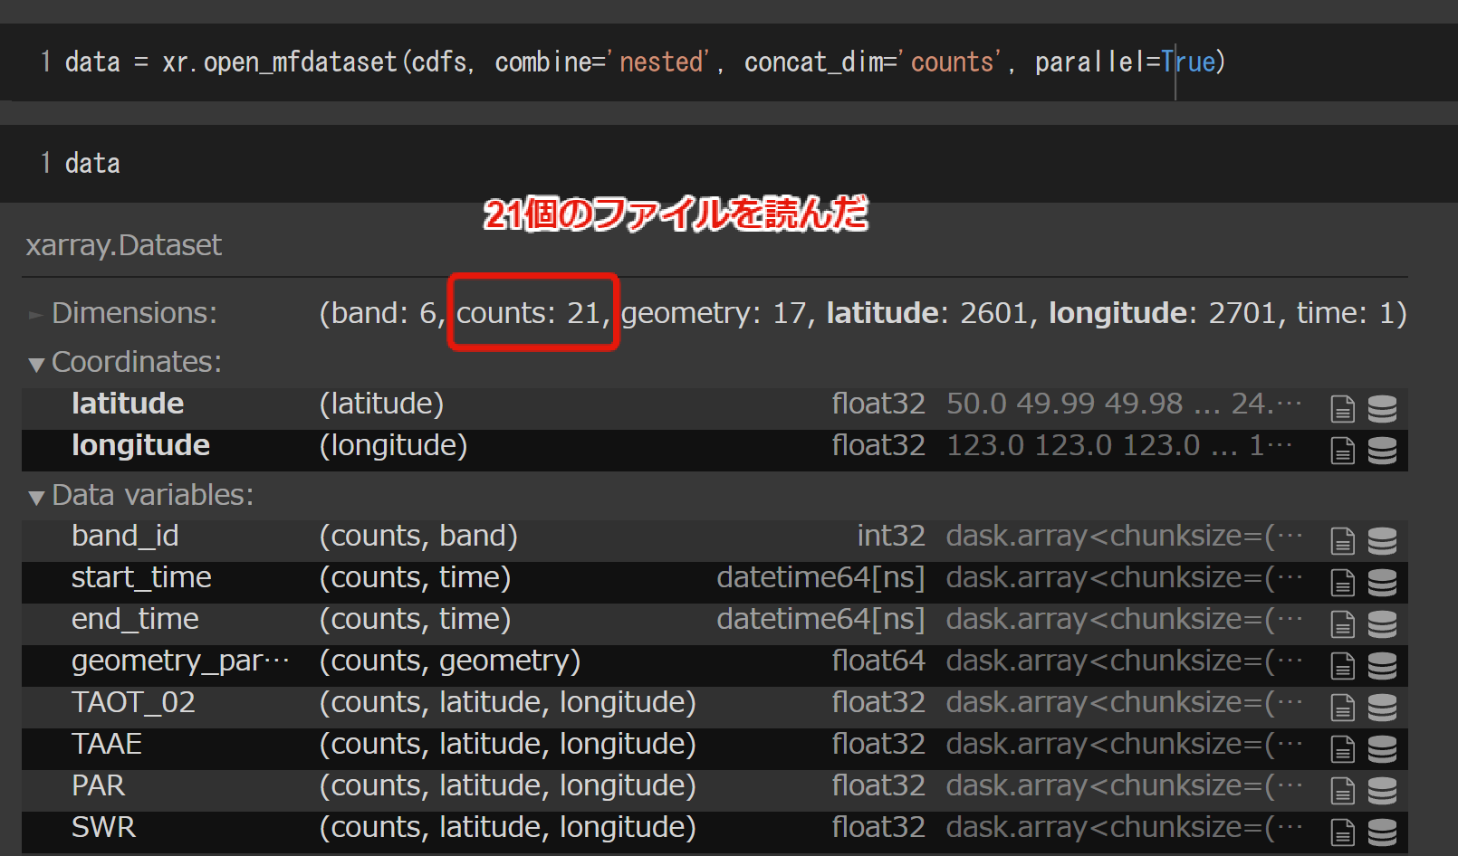
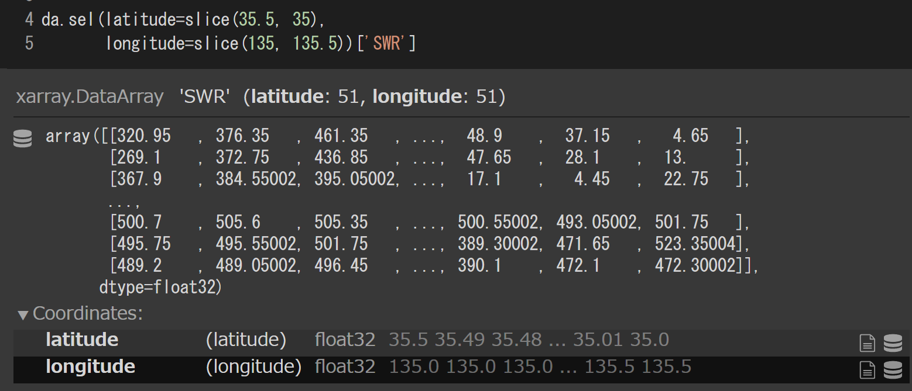
Meteorological data with xarray 2
Using xarray is intuitive and easy to understand.
I think I can get there if I can use pandas.
Files can be readed together.

Slide 52
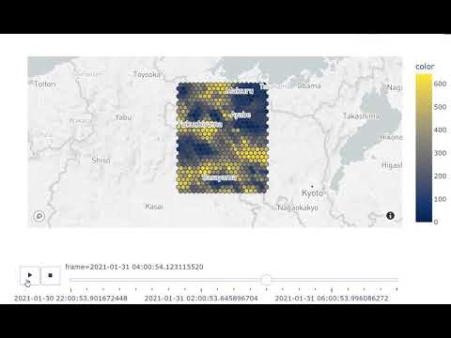
Meteorological data with xarray and plotly
Using Plotly to visualize hourly data.
The more graph move, the more you feel!

Slide 53
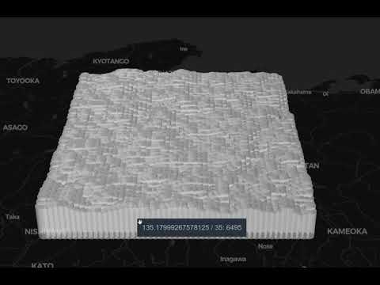
Meteorological data with xarray and pydeck
Express the total for the day.
Group by location and total for one day.
With pydeck.

Slide 54
agenda
Location data / Geospatial information
File Formats
How to use
Personal behavior data
National census
Himawari
Satellite Images

Slide 55
agenda
Location data / Geospatial information
File Formats
How to use
Personal behavior data
National census
Himawari
Satellite Images

Slide 56
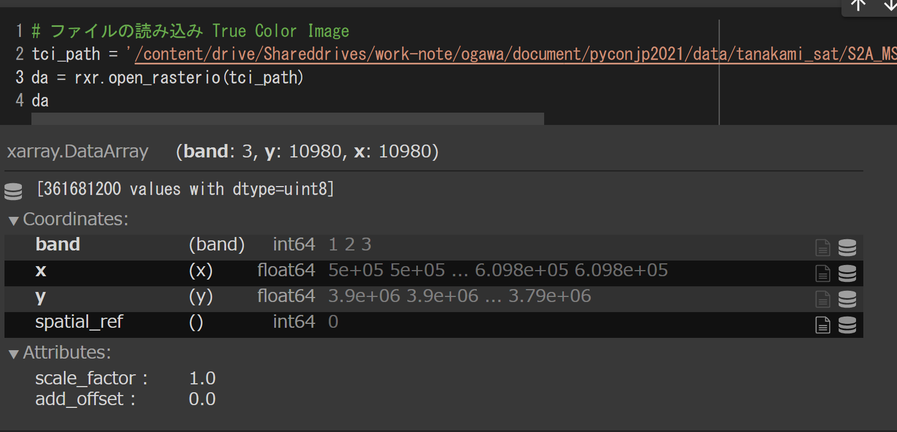
Satellite Images
Data: Sentinel2
Colab: https://colab.research.google.com/drive/1hajaEIBbUwGWvm5JbnJ6y0WhsMDwc3Yi?usp=sharing
License Copernicus Open Access Hub (Link)
There are various files, but the raster data is in a jp2 file.
Read and process the file using rioxarray.
Read 1pixel / 10m TCI image
Observe the local Mt. Tanakami (I can only go back a year for convenience, so I will compare the two)

Slide 57
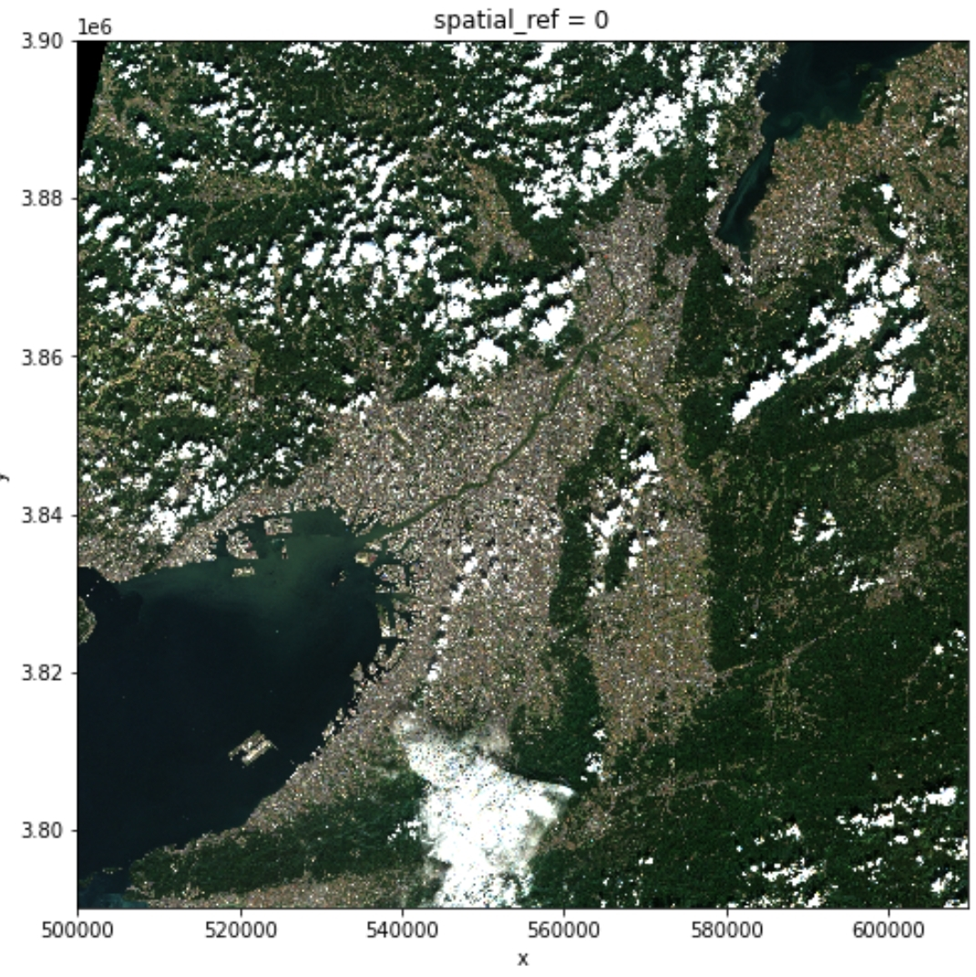
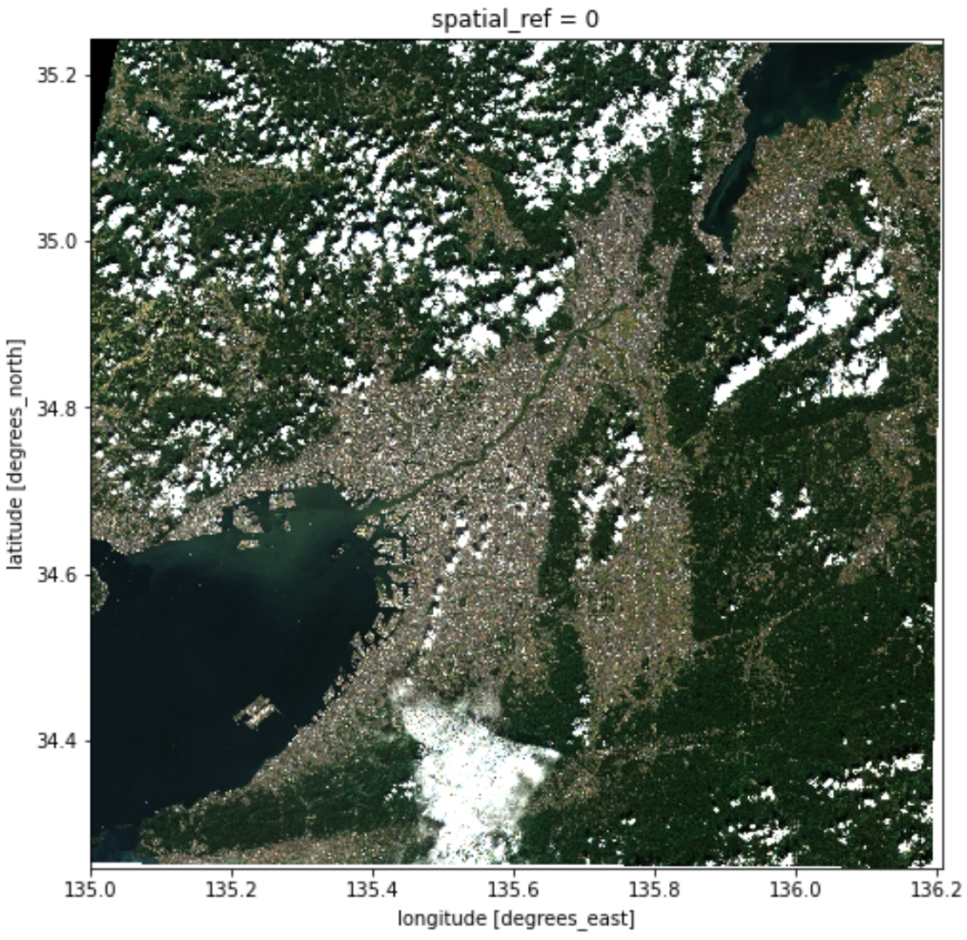
Satellite Images 2
Visualization
Satellite images of Osaka, Kyoto, Nara, and Shiga
Changing the CRS（EPSG:32653 => EPSG:4326）
Call up the location data of the part of Mt. Tanakami you want to see that you prepared in advance, and cut it out.

Slide 58
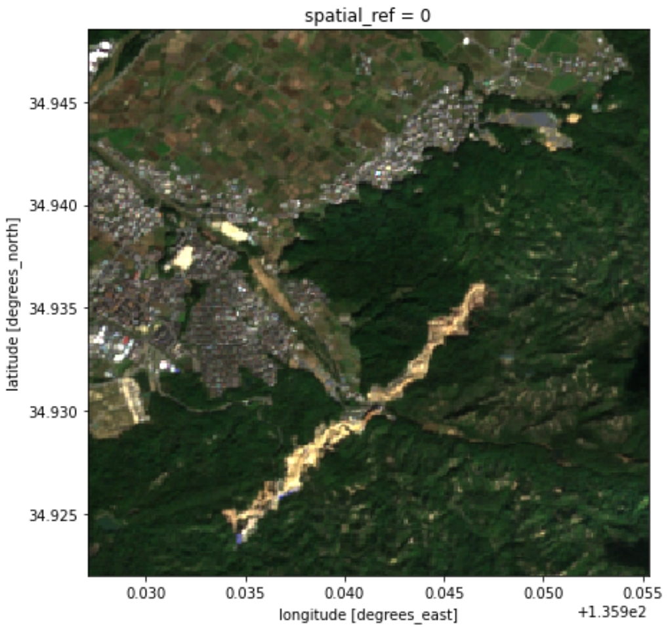
Satellite Images 3 : 2020/10/12

Slide 59
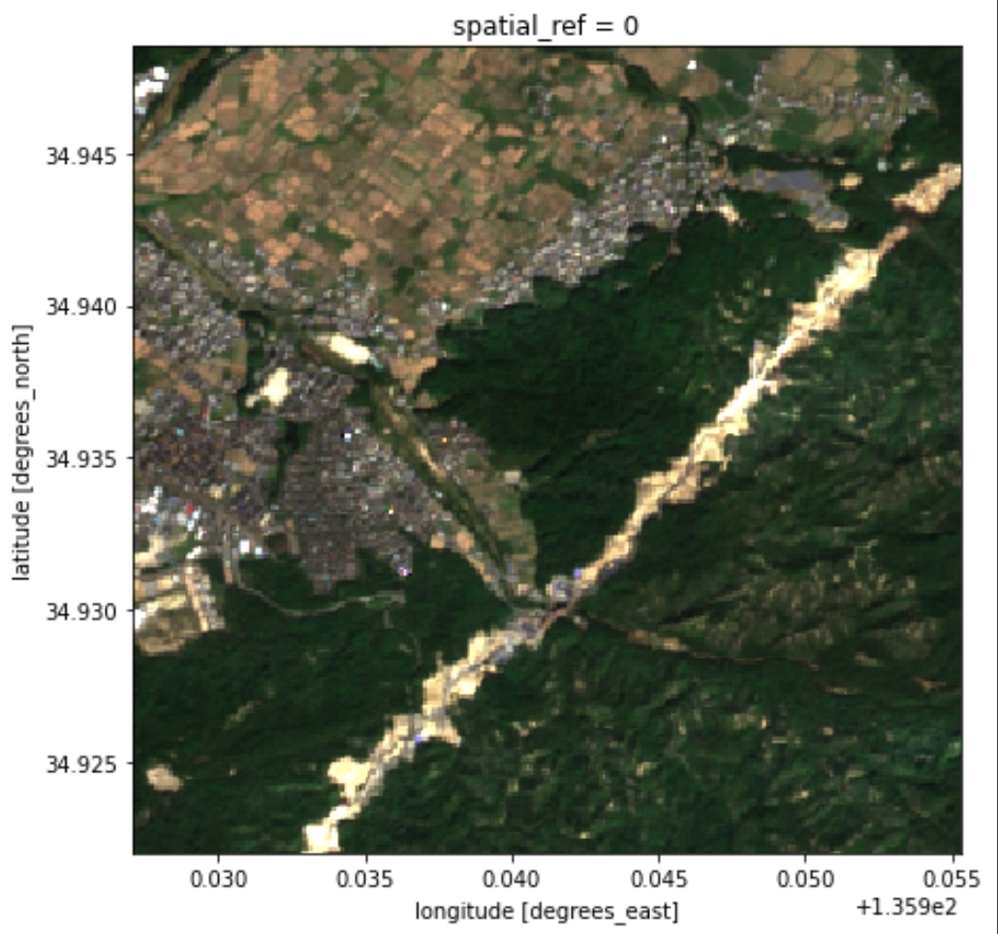
Satellite Images 4 : 2021/10/2

Slide 60
conclusion
It's easy to make use of location data in Python.
On the other hand, the exact knowledge is quite complex, and I'd like to work with an expert to touch this area.
Once the data is in place, it will be possible to help solve social issues.
"How do we act?" may be the challenge for those of us who can touch data or write code.

Slide 61

conclusion２
from ghibli
https://www.ghibli.jp/works/mononoke/#frame

Slide 62

Thank you very much

Slide 63
参考資料
books(only japanese)
地図リテラシー入門 羽田康祐 ペレ出版
その問題、デジタル地図が解決します 中島円 ペレ出版
GIS地理情報システム 矢野桂司 創元社
for study
GEO-PYTHON(University of Helsinki) Link

Slide 64
Packeges
shapely
Document: https://shapely.readthedocs.io/en/stable/
geopandas
Document: https://geopandas.org/
xarray
Document: http://xarray.pydata.org/en/stable/
folium
Document: https://python-visualization.github.io/folium/
plotly
Document: https://plotly.com/python/
pydeck
Document: https://deckgl.readthedocs.io/en/latest/

Slide 65
Data
Behavior data of 11 people
GPS trajectory linked data project Link
kokuse-chosa
eStat Statistics GIS https://www.e-stat.go.jp/gis
kokuse-chosa (2015) 250meter mesh
Himawari
JAXA HIMAWARI MONITOR: Link
Sentinel2
Copernicus Open Access Hub: Link

